Slide 1

Software Testing
Unit 2
System Testing
Prof Raghu B. A. Rao
Department of Computer Science and Engineering

Slide 2

System Testing
List of Contents
System Testing
System Testing (End-to-End Testing)
Why is System Testing done?
Different Perspectives of System Testing
Functional Testing
Non Functional testing
Design/Architecture Verification
Business Vertical Testing
Beta Testing
Department of Computer Science and Engineering
‹#›

Slide 3
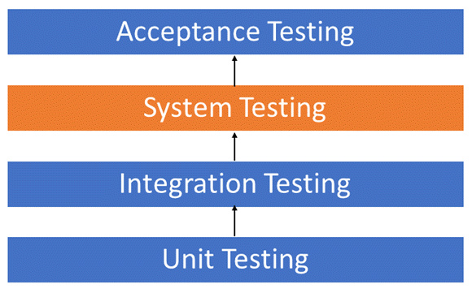
System Testing

Slide 4
System Testing
System testing tests a completely integrated system to verify that its compliant with its specified requirements.
It seeks to detect defects both within the "inter-assemblages" and also within the system as a whole
Testing in the context of a Functional Requirement Specification(s) (FRS) and/or a System Requirement Specification (SRS).
Focus is functionality and performance and not negative / exception cases ( which are already done by now )
“System testing is the only phase of testing which tests both functional and non-functional aspect of the product”
Functional : real time usage if product
Non Functional : System brings different type of testing

Slide 5
System Testing (End-to-End Testing)
Testing “full aspect of main functionality” – A business process for example.
Create scenarios
Story-line : Develop a story-line that combines various activities of the product
Life-cycle / state transitions: Consider an object, derive the different transitions / modification that happen to the object and derive scenarios to cover them
Deployment / implementation details from customer
Business verticals: Visualizing how a product / software will be applied to different business verticals and create a set of activities as scenarios (e.g., insurance, life sciences)
Battle-ground scenarios: Create some scenarios to justify “the product works” and some scenarios to “try and break the system” to justify “the product doesn’t work.”

Slide 6
Why is System Testing Done?
Provide independent perspective in testing.
Bring in customer perspective in testing.
Provide a fresh pair of eyes to discover defects not found earlier by testing.
Test product behaviour in a holistic, complete and realistic environment.
Test both functional and non-functional aspects of the product.
Build confidence in the product.
Analyze and reduce the risk of releasing the product
Ensure all requirements are met and ready the product for acceptance testing.

Slide 7
Different Perspectives of System Testing
Test Phase
Global perspective
Component Support
System Testing
Sub- System Testing
Product Organization
System Testing
System Testing
Solution Integration
System Testing
Solution Testing

Slide 8
Functional Testing
Type of software testing that validates the software system against the functional requirements/specifications.
The purpose of Functional tests is to test each function of the software application, by providing appropriate input, verifying the output against the Functional requirements.
Functional testing mainly involves black box testing and it is not concerned about the source code of the application.
This testing checks User Interface, APIs, Database, Security, Client/Server communication and other functionality of the Application Under Test.
The testing can be done either manually or using automation.

Slide 9
Non Functional Testing
Type of Software testing to check non-functional aspects (performance, usability, reliability, etc) of a software application.
It is designed to test the readiness of a system as per nonfunctional parameters which are never addressed by functional testing.
Example - check how many people can simultaneously login into a software.
Non-functional testing is equally important as functional testing and affects client satisfaction.

Slide 10

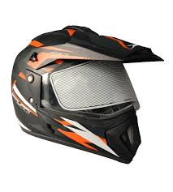
What is the functional requirement of this milk cartoon?
What is the non functional requirement of this hard helmet

Slide 11
Testing Aspects | Functional Testing | Non Functional Testing
Involves | Product feature and functionality | Quality factors
Tests | product Behavior | Behavior and experience
Result Conclusion | Simple steps written to check expected results | Huge data collected and analysed
Results varies due to | Product Implementation | Product Implementation, resources and configuration
Testing Focus | Defect Detection | Qualification of Product
Knowledge Required | Product and domain | Product, domain, design,architect, statistical skill.
Failure is normally due to | code | architecture, design and code
Testing phase | Unit, component, integration system | System
Test case repeatability | Repeated many times | Repeated only in case of failures and different configurations
Configuration | One time set up for a set of test cases | Configuration changes for each test case.

Slide 12
Types of Non-Functional Testing
Performance & Load Testing - To evaluate time taken of system to perform its required functions in comparison with different versions of same product or different competitive
product is called performance testing.
Scalability Testing - A testing that requires enormous amount of resource to find out the maximum capability is the system parameters.
Reliability Testing - Checks whether the software can perform a failure-free operation for a specified time period in a particular environment.
Stress Testing - Evaluating the system beyond the limits or specified requirements to ensure the system does not break down unexpectedly.
Interoperability Testing - Testing is done to ensure that two or more products can exchange information.
Localization Testing - Testing conducted to verify that the localized product works in different languages.

Slide 13
Tests that are Part of System Testing
Following types of tests are part of system testing:
Black-box / White-box / Grey-box
Functional & Non functional
Software Performance testing
Smoke and Sanity testing
Regression testing
Installation testing
Destructive testing
Usability
Localization
Boundary tests
Startup/shutdown tests
Platform tests
Load/stress tests
Security testing
Recovery tests

Slide 14
Smoke vs Sanity Testing
Smoke Testing | Sanity Testing
Smoke testing is done to assure that the acute functionalities of program is working fine. | Sanity testing is done to check the bugs have been fixed after the build.
Smoke testing is also called subset of acceptance testing. | Sanity testing is also called subset of regression testing.
Smoke testing is performed by either developers or testers. | Sanity testing is normally performed by testers.
Smoke testing may be stable or unstable. | Sanity testing is stable.
Smoke testing is scripted. | Sanity testing is usually not scripted.
Smoke testing is done to measures the stability of the system/product by performing testing. | Sanity testing is done to measures the rationality of the system/product by performing testing.
Smoke testing is used to test all over function of the system/product. | Sanity testing is used in the case of only modified or defect functions of system/products.
Smoke testing can be performed either manually or by using automation tools. | Sanity testing is commonly executed manually, not by using any automation approach.
Smoke testing is performed when new product is built. | Sanity testing is conducted after the completion of regression testing.

Slide 15
Design/Architecture Verification
Test cases are developed and checked against the designs and architecture to see whether they are actual product level test cases.
Functional test cases focuses on the behaviour of the entire product.
This techniques helps to validate the product features that are written based on the customer scenarios.

Slide 16
Business Vertical Testing
Business vertical testing is a process in which a product is being used and tested for different business verticals such as banking, insurance, asset management, etc., and also verifying the business operations and its usage. The two types are:
Simulation – In the simulation of a business vertical test, the customer or the tester assumes requirements, and the business flow is tested.
Replication – In the replication process, the client data and process are acquired and the product is fully customized, and tested, and the customized product as it was tested is released to the client.

Slide 17
Beta Testing
Beta testing is a type of User Acceptance Testing.
Testing of the product performs by the real users of the software application in the real environment. Beta version of the software is released to a restricted number of end-users to obtain the feedback of the product quality.
Beta testing reduces the risk of failure and provides the quality of the product through customer validation.

Slide 18
THANK YOU
Prof Raghu B. A. Rao
Department of Computer Science and Engineering

